Slide 2
GitOps, gestione configurazioni e dati sensibili
Enrico Sabbadin, Rauno De Pasquale

Slide 3
Agenda
Overview
GitOps: an introduction
Azure App Configuration
Azure Key Vault (AKV) intro
AKV integration in Azure app configuration
Integrate app config and AKV in Azure DevOps (gitOps)
Secrets management in Git and the developers’ machine

Slide 4
GitOps – Yet one other Ops?

Slide 5
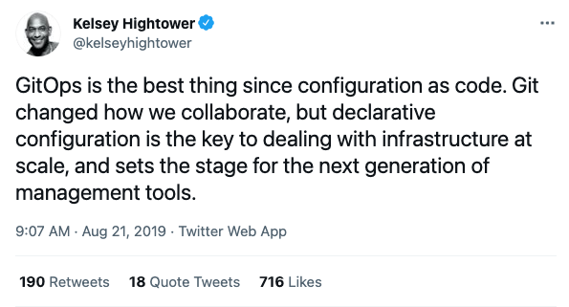
GitOps: Overview

Slide 6
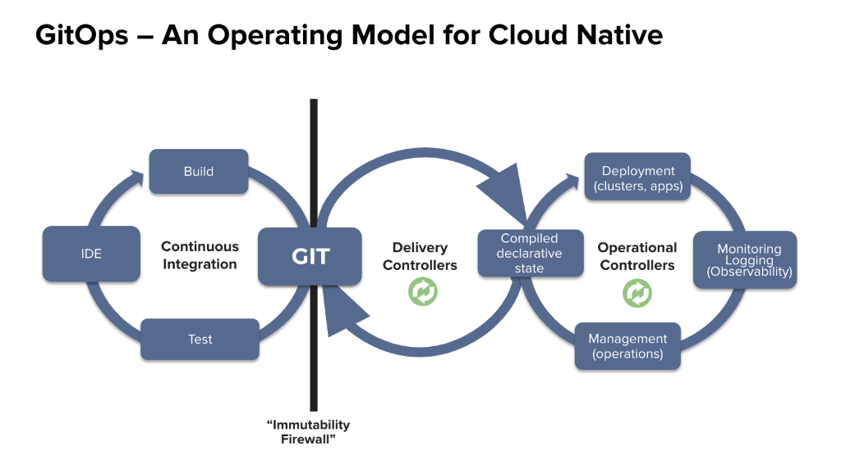
GitOps: Overview
“DevOps is all about the cultural change in an organization to make people work better together.
GitOps is a technique to implement Continuous Delivery.”
Notes:
The term GitOps has been created by weawework in 2017.
From Gitops.tech: “DevOps is all about the cultural change in an organization to make people work better together. GitOps is a technique to implement Continuous Delivery.”

Slide 7

GitOps: context and benefits
The entire system described declaratively.
The canonical desired system state versioned in Git.
Approved changes that can be automatically applied to the system.
Software agents to ensure correctness and alert on divergence.
Easy and Fast Error Recovery
Easier Credential Management
Self-documenting Deployments
Shared Knowledge in Teams
Notes:
GitOps organizes the deployment process around code repositories as the central element. There are at least two repositories: the application repository and the environment configuration repository. The application repository contains the source code of the application and the deployment manifests to deploy the application. The environment configuration repository contains all deployment manifests of the currently desired infrastructure of an deployment environment.

Slide 8
Azure App configuration

Slide 9
App configuration: Overview
Paas service to store key values pairs to centralize settings and feature flags
Dynamically change application settings without redeploy or restart an application
Strong separation between configurations and code artifact/package
Works as configuration provider for dotnet and dotnetcore
As many (any ?) other azure resource, can be managed using
REST API
SDK for different languages
Az cli
Powershell module
Azure portal

Slide 10
App configuration: Overview
Internal flat structure, but prefixes and labels allow for filtering and logical hierarchies
Allows storage of strings with an optional content type
A json string in a single slot with proper content type can be deserialized in a complex .NET configuration object
By default, allows access through public IP addresses. You can also restrict access to specific IP ranges, service endpoints, virtual networks, or private endpoints.
Supports soft-delete

Slide 11
App configuration authentication
Access keys
Azure AD credentials
Users, Groups
Service principals
Using Secrets or certificates as credentials
Managed identities

Slide 12
App configuration authorization
Access keys
Read and write
Dont’t use them, disable them (unless you code runs on premise)
Azure AD: Standard Azure approach RBAC based
RBAC: App Configuration Data Owner, App Configuration Data Reader
Assign to principal at the app configuration level

Slide 13
DEMO: Azure App Configuration as .NET configuration provider
Context: azure web app registering app config and akv instances as configuration providers
Configuration explorer
app-config-basic
basic keys, “complex” keys
app-config-refresh
Key refresh

Slide 14
App Configuration High-Availability
Azure App Configuration is a regional service
Supports availability zones to protect from single data center failure
Each configuration store is created in a particular Azure region. A region-wide outage affects all stores in that region. App Configuration doesn't offer automatic failover to another region.
public static IHostBuilder CreateHostBuilder(string[] args) => Host.CreateDefaultBuilder(args) .ConfigureWebHostDefaults(webBuilder => webBuilder.ConfigureAppConfiguration((hostingContext, config) => { var settings = config.Build();
config .AddAzureAppConfiguration(settings["ConnectionString_SecondaryStore"], optional: true) .AddAzureAppConfiguration(settings["ConnectionString_PrimaryStore"], optional: true); }) .UseStartup<Startup>());

Slide 15
Azure Key Vault

Slide 16
Azure Key Vault: Basics
Secrets Management
Key Management
Certificate Management
As App configuration, it can be managed via portal, az cli, sdk, REST, powershell
HA: Content is replicated within a region and to a secondary region

Slide 17
AKV in the Azure portal
Azure Key Vault in Azure Portal
Keys, Certificates, Secrets

Slide 18
Secrets Management
Key Vault stores and manages secrets as sequences of octets (8-bit bytes), with a maximum size of 25k bytes each
All secrets in your Key Vault are stored encrypted
The Azure Key Vault service encrypts your secrets when you add them, and decrypts them automatically when you read them.
By default, Key Vault allows access through public IP addresses. You can also restrict access to specific IP ranges, service endpoints, virtual networks, or private endpoints.

Slide 19
AKV authentication
NO ACCESS KEYS
Azure AD credentials
Users, Groups
Service principals
Secrets, certificates as credentials
Managed identities
Use Managed identities whenever possible

Slide 20
AKV authorization
Standard RBAC with AKV dedicated roles
Allows fine grained control, also for a specific key/secret/Certificate
AKV policies : AKV specific authorization model
Can be applied only at key, secret or certificate level
Show on the azure portal

Slide 21
Azure App Configuration & AKV references to secrets
az appconfig kv set-keyvault -n MyAppConfiguration --key mykey --secret-identifier https://myvault.vault.azure.net/Secrets/akvscret
App configuration has no Access to AKV .. It just get a reference. Caller must have rights to read from AKV
Azure App Configuration
Azure Key Vault
App
Settings
1) Get values (settings + key vault references)
Values
Secrets
Key vault references
2) Get values for keys that are key vault reference

Slide 22
AKV as .NET configuration provider
DEMO
AKV Only
AKV references in App configuration

Slide 23
Best practices
https://docs.microsoft.com/en-us/azure/key-vault/general/best-practices
Use one app configuration / key vault instance per “application” and environment
Avoid authorization model with permission at secret, keys level
https://docs.microsoft.com/en-us/azure/azure-app-configuration/howto-best-practices
Do not use connection string, but leverage principals + RBAC (managed identity whenever possible)
Fine tune refresh timeout, use sentinel key
Use 2 instance for HA

Slide 24
GitOps based management

Slide 25
GitOps based management
The azure portal is read only !!

Slide 26
GitOps based management: azure app configuration
Manage azure app config settings as you do for your source code
Store in git
Automate insert / update / delete, pushing them using az cli as part of the deploy pipeline
Azure app config cli has an import command (also available as an ado task).
It does not allow to define content type and key vault references for specific keys, need to maintain 3 separate tasks for basic entries, json content type and key vault references
You might want to give a try to a custom script using az cli directly

Slide 27
GitOps based management: akv
Manage azure akv settings as your source code
Store in git
Automate insert / update / delete, pushing them using az cli as part of the deploy pipeline
AKV cli has no batch import functionality.
You might want to give a try to some marketplace tasks, or ..
Maintain your own format in git and write custom script that use az cli directly

Slide 28
GitOps based management
DEMO

Slide 29
Secrets and Git

Slide 30
Avoiding secrets in GIT
Using AKV we don’t deploy assets containing secrets in plain text … still your secops friends are not happy that you store secrets in git
Use Azure Devops secrets variables
Poor history, not GitOps oriented
b) Store secrets in Git encrypted using AKV keys
Encryption part does not need to be protected (use public key)
Only principal used to deploy in azure devops will have rights to decrypt them right before pushing to AKV

Slide 31
AKV Key Management
software-protected: asymmetric encryption only
hardware-protected asymmetric and symmetric encryption (HSM)
#az keyvault key create --vault-name myvault1 --name mykey1 --size 4096
# encrypt (use public key)
$x= az keyvault key encrypt --name mykey1 --vault-name myvault1 --value $secret --data-type plaintext --algorithm RSA-OAEP | ConvertFrom-Json
write-host "encrypted " $x.result
# decrypt (use private key)
$y= az keyvault key decrypt --name mykey1 --vault-name myvault1 --value $x.result --data-type plaintext --algorithm RSA-OAEP | ConvertFrom-Json
write-host "decripted " $y.result

Slide 32
Secrets and the dev environment: 1
Not using app configuration / AKV instances in Dev
Comment out with #if DEBUG app config and akv registration
For secrets use .net secrets configuration provider (available by default in .net core)
They are stored in plain text in a file, but the file is out of git folder root
Share among devs using you company password keeper tool

Slide 33
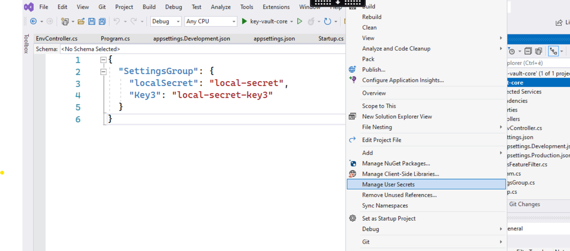
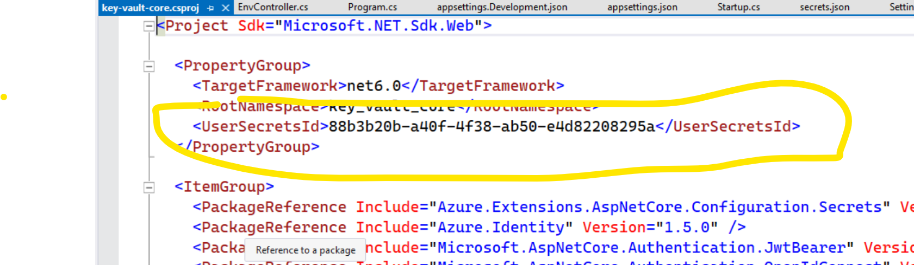
Local secrets provider in dev machine
C:\Users\enrico.sabbadin\AppData\Roaming\Microsoft\UserSecrets\88b3b20b-a40f-4f38-ab50-e4d82208295a

Slide 34
Secrets and the dev environment: 2
The developer env access App config and AKV dv instances
One change affects all deveopers
You must implement a custom config provider configuration order so that app.config/secrets providers wins over azure app config and AKV
This allows a developer to overwrite locally some settings coming from a shared app config/akv
DEMO
app-config-provider-order
How to: app.config wins over app configuration

Slide 35
Git repo
https://github.com/sabbadino/global-azure-app-config-key-vault

Slide 36
QUESTIONS ?

